Slide 1

l
ArUco handles lightweight positioning and detection of simple objects, while YOLO can identify more complex and dynamic targets. By assigning tasks to the appropriate algoithms, the system can achieve efficient real-time processing with limited resources. Combining these two technologies leverages their strengths and compensates for their weaknesses when used individually.
Second-Generation System

Slide 2
Agenda
Applying ChatGPT and Traditional Deep Learning in Robot Control
Design Concept
Second-Generation System Design and Architecture
The Issue of Prompt Engineering in Language Models
Future Work
ArUco handles lightweight positioning and detection of simple objects, while YOLO can identify more complex and dynamic targets. By assigning tasks to the appropriate algoithms, the system can achieve efficient real-time processing with limited resources. Combining these two technologies leverages their strengths and compensates for their weaknesses when used individually.

Slide 3
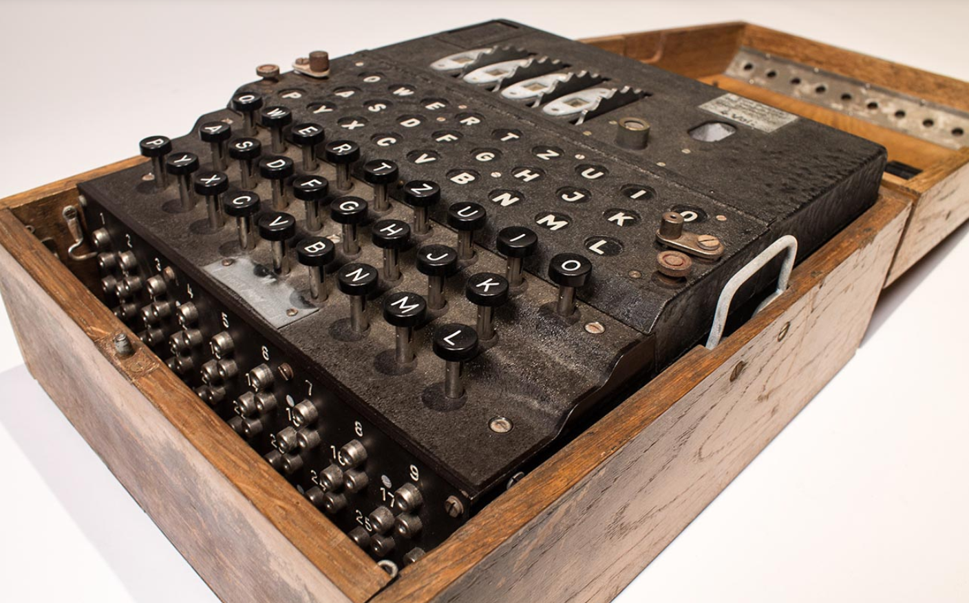

Cloud Atlas Plan
Applying ChatGPT and Traditional Deep Learning in Robot Control
Enigma Machine Hack
During World War II, Germany designed the Enigma machine, a type of information encryption that can be changed, with the initial settings updated every day, and has 1.5×10^20 possibilities. In order to decipher the code, the British organized a team of thousands of people hoping to crack the code, but it was impossible.
But Turing said that [Humans can never defeat machine，only machine can defeat machine.]
So Turing designed a machine called "Bomb", which only takes a few hours to crack the possibility that humans cannot crack.
https://www.youtube.com/watch?v=oriSxpi5VB0
https://www.youtube.com/shorts/i2_BvGqYIYc
ArUco handles lightweight positioning and detection of simple objects, while YOLO can identify more complex and dynamic targets. By assigning tasks to the appropriate algoithms, the system can achieve efficient real-time processing with limited resources. Combining these two technologies leverages their strengths and compensates for their weaknesses when used individually.
Alan Turing-the father of AI

Slide 4
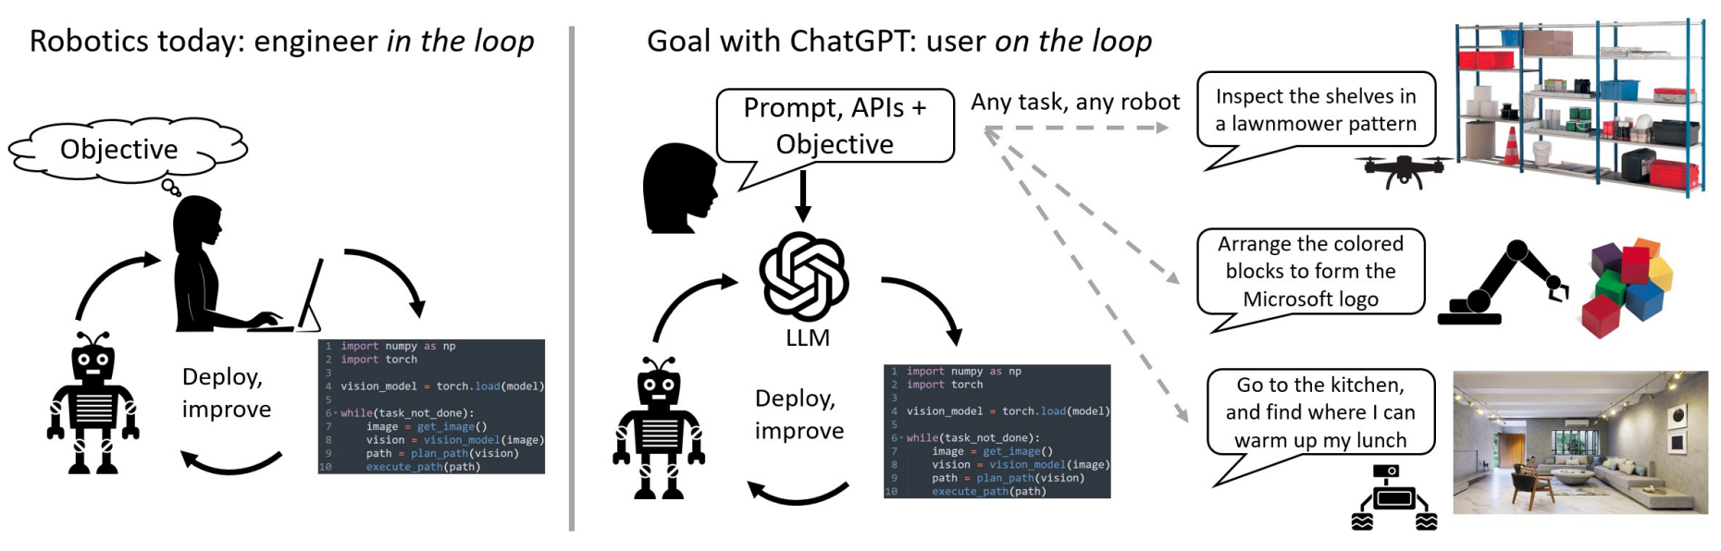

Cloud Atlas Plan
Applying ChatGPT and Traditional Deep Learning in Robot Control
Humans can never defeat machines，Only machine can defeat machine.
Current robotics pipelines require a specialized engineer in the loop to write code to improve the process. Our
goal with ChatGPT is to have a (potentially non-technical) user on the loop, interacting with the language model through
high-level language commands, and able to seamlessly deploy various platforms and tasks.
Traditional control methods and large language model robots
S. H. Vemprala, R. Bonatti, A. Bucker, and A. Kapoor, "ChatGPT for Robotics: Design Principles and Model Abilities," IEEE Access, vol. 12, pp. 1–10, 2024.

Slide 5
Cloud Atlas Plan
Applying ChatGPT and Traditional Deep Learning in Robot Control
Advantages of ChatGPT Robot
1.Text Understanding:
ChatGPT robots can understand complex instructions and different languages.
2.Text Memory:
ChatGPT robots can remember and recall past conversations or instructions.
3.Function Expansion:
The robot can add new functions just by changing the prompts.
S. H. Vemprala, R. Bonatti, A. Bucker, and A. Kapoor, "ChatGPT for Robotics: Design Principles and Model Abilities," IEEE Access, vol. 12, pp. 1–10, 2024.

Slide 6
Agenda
Applying ChatGPT and Traditional Deep Learning in Robot Control
Design Concept
Second-Generation System Design and Architecture
The Issue of Prompt Engineering in Language Models
Future Work
ArUco handles lightweight positioning and detection of simple objects, while YOLO can identify more complex and dynamic targets. By assigning tasks to the appropriate algoithms, the system can achieve efficient real-time processing with limited resources. Combining these two technologies leverages their strengths and compensates for their weaknesses when used individually.

Slide 7
Cloud Atlas Plan---SKY NET Ⅲ
Start
Prompt words input ②
Text input ①
Define variables
Speech input ①
Direct input commands
Google Speech to Text
GPT understands sentences and gives instructions
Recognition failed
JSON command
Action Interpreter
...
...
Action Library 1
nod head
Action Library 2 Shake head
Action Library 3 Zero
Action Library n
Grasping objects
The commands entered into the system each time are ① and ②.
The sections highlighted in red indicate tasks planned for future implementation

Slide 8
Cloud Atlas Plan---SKY NET Ⅲ
Experiments
Steps:
1. Start
The system begins, ready to receive user input.
2. Input Types
The system supports two types of input:
Text Input: The user can directly type commands using the keyboard.
Speech Input: The user can provide voice commands, and the system uses Google Speech to Text to convert the spoken input into text.
3. Command Recognition
For text input, the system accepts direct input commands.
For speech input, the system utilizes Google Speech to Text for voice recognition.［Unfinished］
4. Recognition Failure
If the speech recognition fails, the system prompts the user to retry with a new voice input.
5. Understanding and Processing Input
Once the input is successfully recognized (either directly from text input or converted from speech), the system employs GPT to interpret the sentences and generate corresponding instructions. The instructions are typically formatted as JSON.
6. Action Interpreter
The system uses an Action Interpreter to parse the JSON instructions provided by GPT and identify the specific actions to be executed.
7. Action Libraries
Based on the interpreted commands, the system selects the appropriate action library to perform the required actions. The flowchart illustrates some example action libraries.

Slide 9
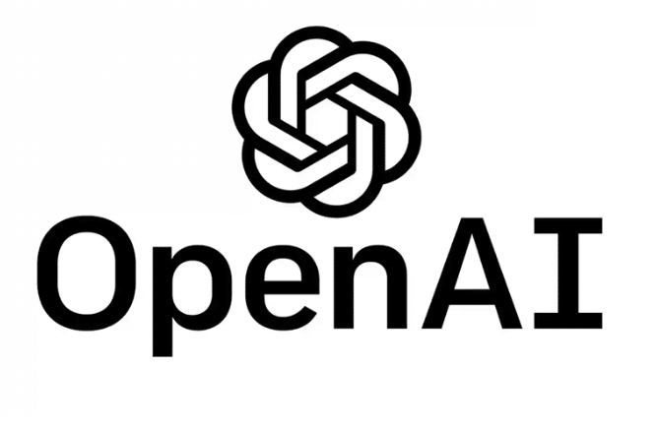


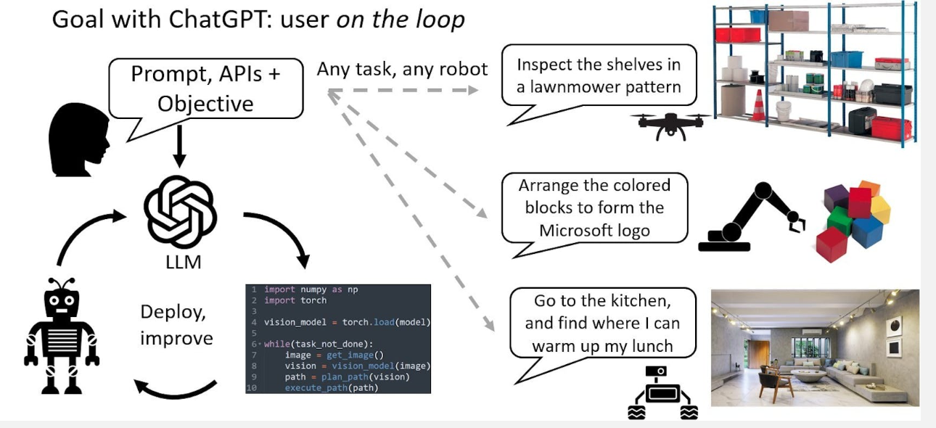

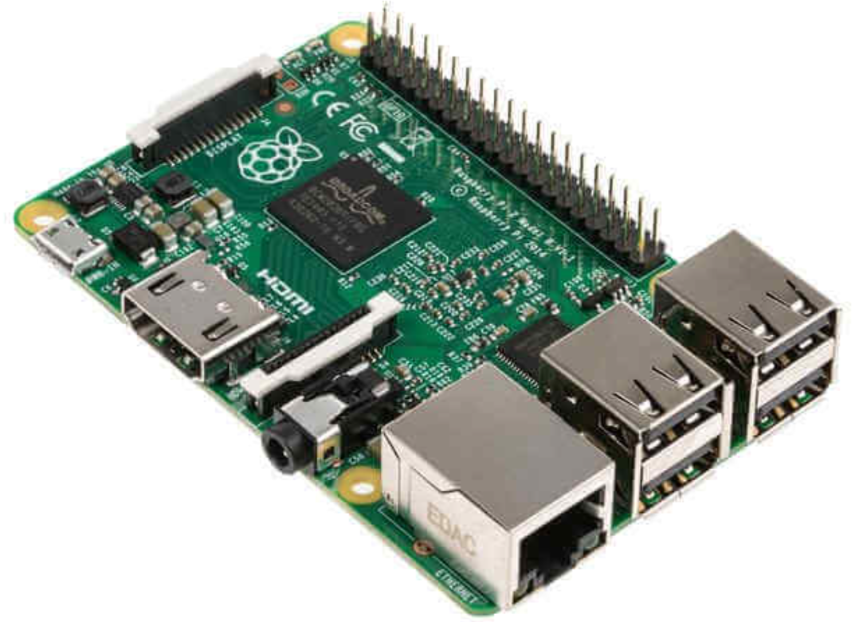

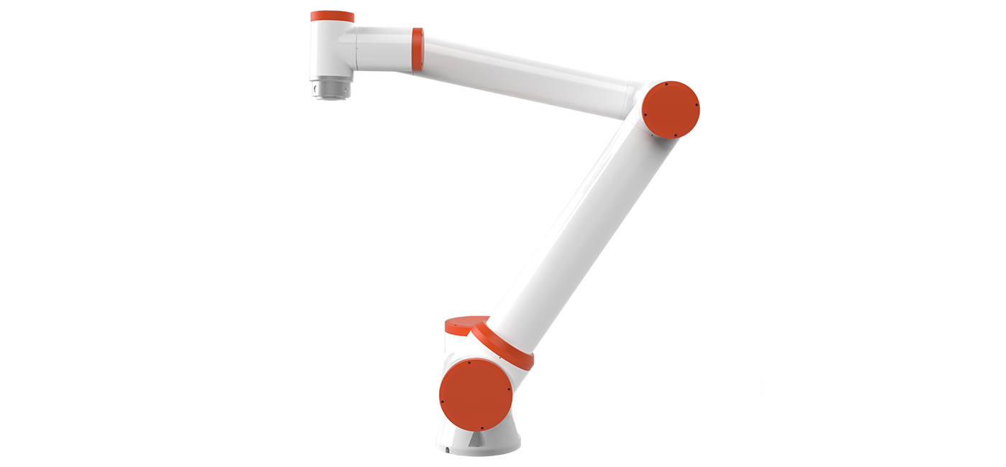


Cloud Atlas Plan---SKY NET Ⅲ
Applying ChatGPT and Traditional Deep Learning in Robot Control
Experiment 7:Raspberry Pi deployment system
ArUco handles lightweight positioning and detection of simple objects, while YOLO can identify more complex and dynamic targets. By assigning tasks to the appropriate algoithms, the system can achieve efficient real-time processing with limited resources. Combining these two technologies leverages their strengths and compensates for their weaknesses when used individually.
Open AI API
Google Speech
-to Text API
Raspberry Pi USB port
SSH protocol
Raspberry Pi GPIO port
Direct command
input
Master Slave

Slide 10
Agenda
Applying ChatGPT and Traditional Deep Learning in Robot Control
Design Concept
Second-Generation System Design and Architecture
The Issue of Prompt Engineering in Language Models
Future Work
ArUco handles lightweight positioning and detection of simple objects, while YOLO can identify more complex and dynamic targets. By assigning tasks to the appropriate algoithms, the system can achieve efficient real-time processing with limited resources. Combining these two technologies leverages their strengths and compensates for their weaknesses when used individually.

Slide 11




Cloud Atlas Plan
Stability of prompts and large language model (LLM) systems
Experiment 7:Black Box System
The language model has a very low understanding of the physical world, so if you want to use the language model to control the robot, you must give it a beginner's textbook.
ArUco handles lightweight positioning and detection of simple objects, while YOLO can identify more complex and dynamic targets. By assigning tasks to the appropriate algoithms, the system can achieve efficient real-time processing with limited resources. Combining these two technologies leverages their strengths and compensates for their weaknesses when used individually.
 | You know | You don’t know
GPT know | Open Area | Blind Area
GPT doesn’t know | Hidden Area | Unknown Area
Interactive Knowledge Window Without the prompt words
Y. Zhang, N. Carlini, and D. Ippolito, "Effective Prompt Extraction from Language Models," Carnegie Mellon-
University and Google DeepMind.

Slide 12
Prompt Engineering
Role Definition | Responsible for parsing user instructions and generating appropriate commands. | You are my robotic arm assistant, and the robotic arm has some built-in functions...
Function List | Provides all available robotic arm functions and their descriptions | - Basic Functions: - back_zero(): - head_dance() - top_view_shot() - Other functions like etc.
Output Format Constraints | Specifies that the model output must follow a JSON format, containing function and response fields. | 【Output format in JSON】<br> {'function': ['function_1()', 'function_2(param)'], 'response': 'Your feedback message'}
Example Guidance | Provides specific input-output examples to guide the model on task requirements and output formatting. | My instruction: give red block. Your output: {'function': ['vlm_move("Move the red block onto my hand")'], 'response': 'I’m here if you need me'}

Slide 13
Cloud Atlas Plan
Stability of prompts and large language model (LLM) systems
Language model prompt 1
prompt | input | output | achieve one's own wishes
My instruction: Reset to the initial position. Your output: {'function': ['back_zero'], 'response': 'What ever you say'} | go back | ['back_zero()'] | yes
My instruction: Reset to the initial dance. Your output: {'function': ['head_dance()'], 'response': 'What ever you say'} | ballet | ['head_dance()'] | yes
My instruction: First reset to the initial position, then dance. Your output: {'function': ['back_zero()', 'head_dance()'], 'response': 'I am in good shape'} | ballet, then nod, and finally return to zero | ['head_dance()'] ['head_nod()'] ['back_zero()'] | yes
x | fly | x | yes
ArUco handles lightweight positioning and detection of simple objects, while YOLO can identify more complex and dynamic targets. By assigning tasks to the appropriate algoithms, the system can achieve efficient real-time processing with limited resources. Combining these two technologies leverages their strengths and compensates for their weaknesses when used individually.
Y. Zhang, N. Carlini, and D. Ippolito, "Effective Prompt Extraction from Language Models," Carnegie Mellon-
University and Google DeepMind.

Slide 14
Cloud Atlas Plan
Stability of prompts and large language model (LLM) systems
Language model prompt 2-Add a prompt word [ shake your head if you can't do it]
prompt | input | output | achieve one's own wishes
My instruction: Reset to the initial position. Your output: {'function': ['back_zero'], 'response': 'What ever you say'} | go back | ['back_zero()'] | yes
My instruction: Reset to the initial dance. Your output: {'function': ['head_dance()'], 'response': 'What ever you say'} | ballet | x | no
My instruction: First reset to the initial position, then dance. Your output: {'function': ['back_zero()', 'head_dance()'], 'response': 'I am in good shape'} | ballet, then nod, and finally return to zero | x | no
x | fly | ['head_shake()'] | yes
ArUco handles lightweight positioning and detection of simple objects, while YOLO can identify more complex and dynamic targets. By assigning tasks to the appropriate algoithms, the system can achieve efficient real-time processing with limited resources. Combining these two technologies leverages their strengths and compensates for their weaknesses when used individually.
Y. Zhang, N. Carlini, and D. Ippolito, "Effective Prompt Extraction from Language Models," Carnegie Mellon-
University and Google DeepMind.

Slide 15
Cloud Atlas Plan
Stability of prompts and large language model (LLM) systems
Summarize 2：
1.The language model cannot understand the physical world. If the system is to be stable, a large number of prompt words must be enriched. If there is a conflict in the prompt words, the system will panic.
2.The language model is a black box. If we can understand the principle of this black box, we can come up with better prompt words and enrich them into a paragraph.
ArUco handles lightweight positioning and detection of simple objects, while YOLO can identify more complex and dynamic targets. By assigning tasks to the appropriate algoithms, the system can achieve efficient real-time processing with limited resources. Combining these two technologies leverages their strengths and compensates for their weaknesses when used individually.
Human Behavior Computer Behavior
Y. Zhang, N. Carlini, and D. Ippolito, "Effective Prompt Extraction from Language Models," Carnegie Mellon-University and Google DeepMind.

Slide 16
Agenda
Applying ChatGPT and Traditional Deep Learning in Robot Control
Design Concept
Second-Generation System Design and Architecture
The Issue of Prompt Engineering in Language Models
Future Work
ArUco handles lightweight positioning and detection of simple objects, while YOLO can identify more complex and dynamic targets. By assigning tasks to the appropriate algoithms, the system can achieve efficient real-time processing with limited resources. Combining these two technologies leverages their strengths and compensates for their weaknesses when used individually.

Slide 17
Cloud Atlas Plan---SKY NET Ⅲ
Start
Prompt words input ②
Text input ①
Define variables
Speech input ①
Direct input commands
Google Speech to Text
GPT understands sentences and gives instructions
Recognition failed
The visual processing module continuously monitors the environment to detect anomalies and generates corresponding corrective commands when deviations from expected behaviors are identified.
JSON command
Action Interpreter
...
...
Action Library 1
nod head
Action Library 2 Shake head
Action Library 3 Zero
Action Library n
Grasping objects
The commands entered into the system each time are ① and ②.
The sections highlighted in red indicate tasks planned for future implementation

Slide 18
SKY NET
Reporter: HANG
THANK YOU

